Slide 1
AIML Clustering
Singapore Polytechnic
P2112646
Justin Wong Juin Hng
Singapore Polytechnic

Slide 2
Table of contents
01.
03.
04.
02.
Singapore Polytechnic
Problem Breakdown
Modelling & Tuning
What are the requirements of the problem statement?
Initial Modelling and Hyperparameter Tuning
Conclusion
Data Manipulation & Exploration
Conclusion of Insights
Data Cleaning, Feature Engineering and Exploratory Data Analysis (EDA)
Singapore Polytechnic

Slide 3
01.
Problem Breakdown
Singapore Polytechnic
What are the requirements of the problem statement?
Singapore Polytechnic

Slide 4
Problem
Singapore Polytechnic
You are the HR manager of a big company, and you have some basic data about your
employees like Age, Gender, Education, Salary, Performance, Resign status, etc.
Problem Statement
As a HR manager, you want to understand your employees so that appropriate
direction can be given to the management to satisfy and retain the employees.
Singapore Polytechnic

Slide 5
02.
Data Manipulation & Exploration
Singapore Polytechnic
Data Cleaning, Feature Engineering and Exploratory Data Analysis (EDA)
Singapore Polytechnic

Slide 6
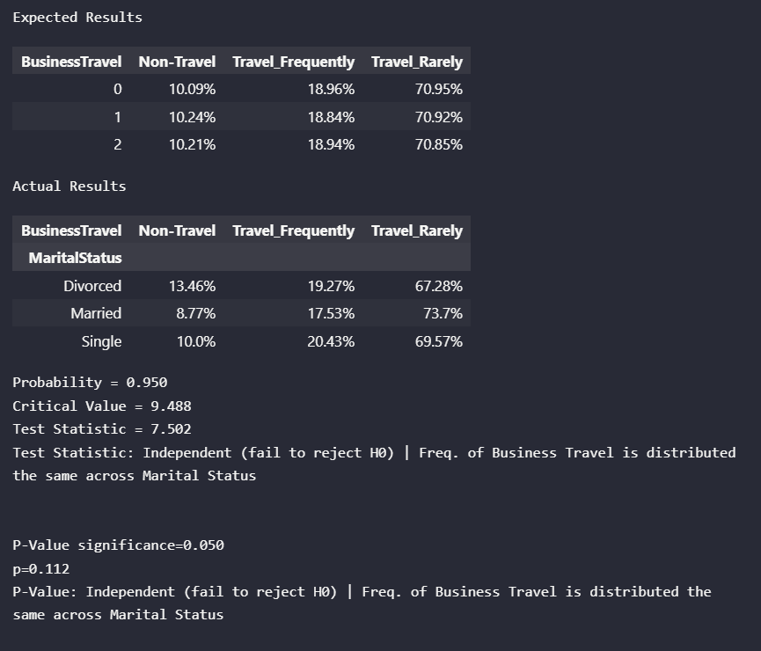
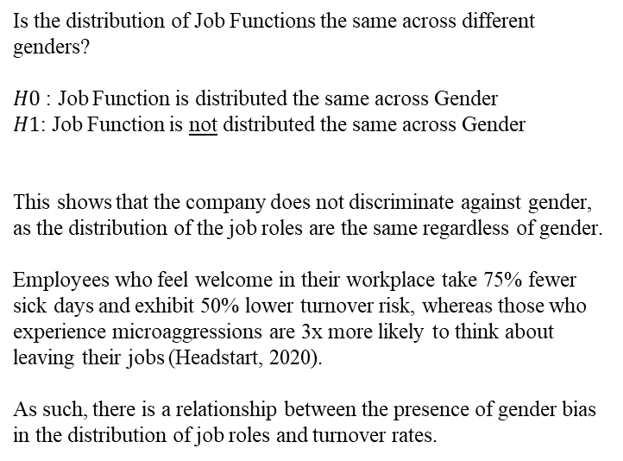
Data Exploration
Singapore Polytechnic
Is the distribution of Job Functions the same across different genders?
$H0$ : Job Function is distributed the same across Gender
$H1$: Job Function is not distributed the same across Gender
This shows that the company does not discriminate against gender, as the distribution of the job roles are the same regardless of gender.
Employees who feel welcome in their workplace take 75% fewer sick days and exhibit 50% lower turnover risk, whereas those who experience microaggressions are 3x more likely to think about leaving their jobs (Headstart, 2020).
As such, there is a relationship between the presence of gender bias in the distribution of job roles and turnover rates.
Singapore Polytechnic

Slide 7
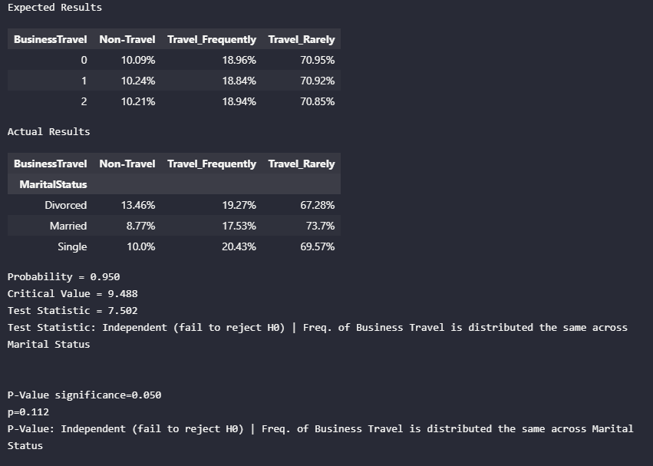
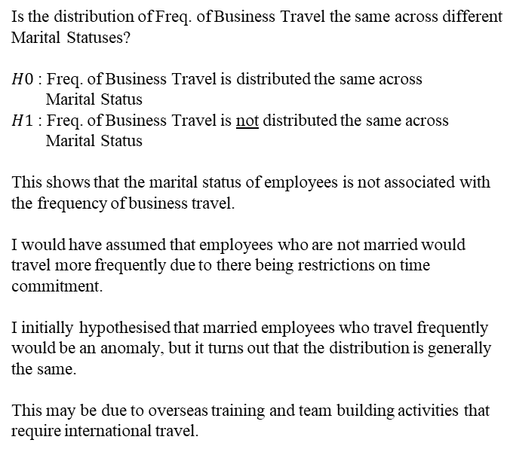
Data Exploration Chi-Square Test for Association
Singapore Polytechnic
Is the distribution of Freq. of Business Travel the same across different Marital Statuses?
$H0$ : Freq. of Business Travel is distributed the same across
Marital Status
$H1$ : Freq. of Business Travel is not distributed the same across
Marital Status
This shows that the marital status of employees is not associated with the frequency of business travel.
I would have assumed that employees who are not married would travel more frequently due to there being restrictions on time commitment.
I initially hypothesised that married employees who travel frequently would be an anomaly, but it turns out that the distribution is generally the same.
This may be due to overseas training and team building activities that require international travel.
Singapore Polytechnic

Slide 8
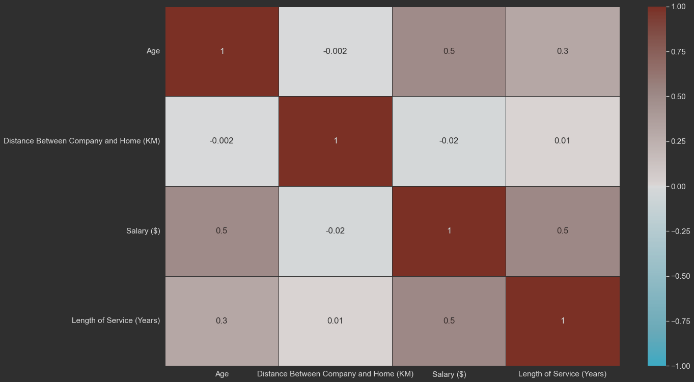
Data Exploration Correlation Matrix
Singapore Polytechnic
We can see that there is a 50% correlation between Salary and Age
There is also a 50% correlation between Length of Service and Salary
However, since it is only 0.5, this means that there is a coin flip chance that these variables are correlated to each other.
Hence, there is no correlation between any of the columns.
Singapore Polytechnic

Slide 9
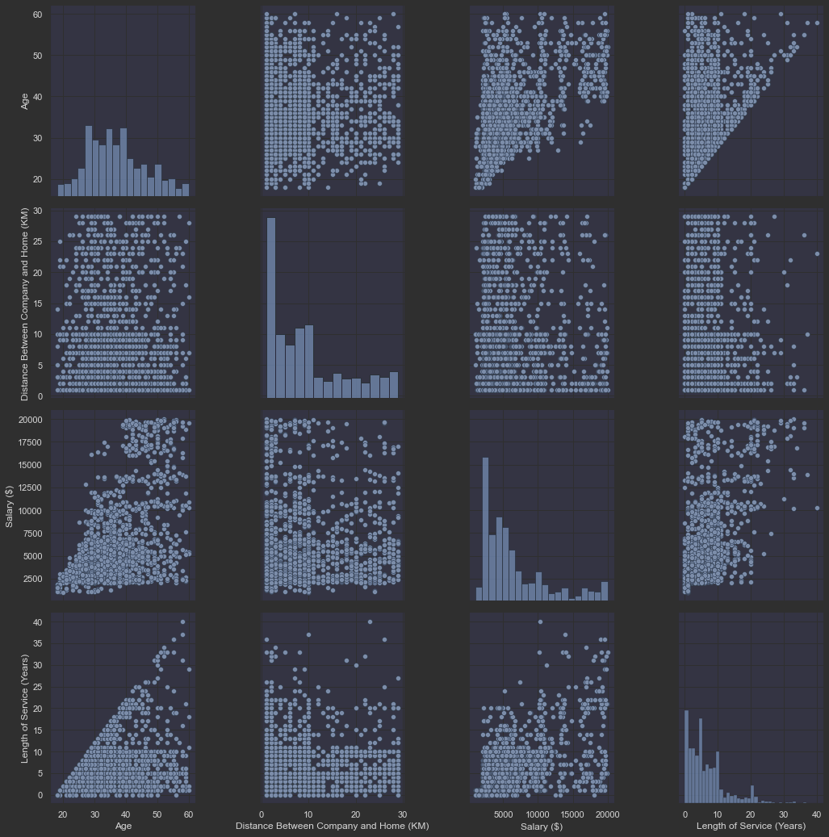
Data Exploration Pair-plot for Pairwise Relationships
Singapore Polytechnic
Age
We can observe that the age of the employee corresponds to how long they stay and serve the company. However, we can see that a decent number of employees leave the company after 10-12 years of service regardless of their age. This trend fades away slightly as employees get older, but the trend is still there.
This means that there is a struggle between job security and the weight of the factors determining them wanting to leave their job. As employees grow older, most employees want to start a family and settle down. Hence, the need for job security is usually higher then. The need for job security decreases nearing the end of the employee’s life, as they have already made enough money to retire. The inverse is true: younger employees do not need job security as they have just entered the workforce and are flexible in wanting to move around and experience differing job roles and/or industries.
Singapore Polytechnic

Slide 10
Singapore Polytechnic
Distance Between Company and Home
We can observe that all ages prefer to stay between 0-10km of the company office, demonstrating that there is no apparently and/or explainable relationship between distance between company office and home and the age of the employee.
Additionally, there is also no relationship between distance between company and home and length of service. However, we can observe from the scatter plot that there is a slight preference that employees whose duration of service at the company is longer do stay between 0-10 km away from the company office, a trend that is also seen in the relationship with Age of Employee.
Most employees in the company prefer to stay less than 12km away from the office, with the graph skewing towards the right, suggesting that employees who stay further away are of lesser numbers. This may be since it is simply not efficient to stay further away from the company. A greater distance from office accounts for greater time taken to travel, more fuel and/or energy wasted and more factors such as:
Housing is closer to living amenities and social locations while office complexes are not located in convenient locations
Office buildings are usually located in the Central Business District (CBD), which means that the greater the convenience, the greater the price paid for housing. As a result, the price per sqft. for housing is proportionately higher the lesser the distance from CBD
Kids schooling also determines priority for housing location; distance from schools and schooling amenities
Singapore Polytechnic

Slide 11
Singapore Polytechnic
Salary
We can observe a slight pattern between years of service at the company and the salary of the employee, suggesting that employees who work longer at the company get salary raises each year.
However, years of service may not be the only factor that is accounting for a raise in salary.
Unaccounted factors such as educational qualifications, years of industry experience, job role and the hierarchical seniority of the job role itself play major roles in affecting the salary. A fresh PhD graduate can provide as much value to the company as can an industry-certified professional with only a graduate diploma but 10 years more work experience.
Hence, length of service is not the only determining factor behind salary.
Most employees in the company are not paid more than $7000 a month, with the graph of salary count skewing towards the right, suggesting that corporate employees that are paid more are of lesser numbers. These may be employees who are in senior job roles within the company, and naturally the ratio between a single manager and several employees account for this skew in the data.
Singapore Polytechnic

Slide 12
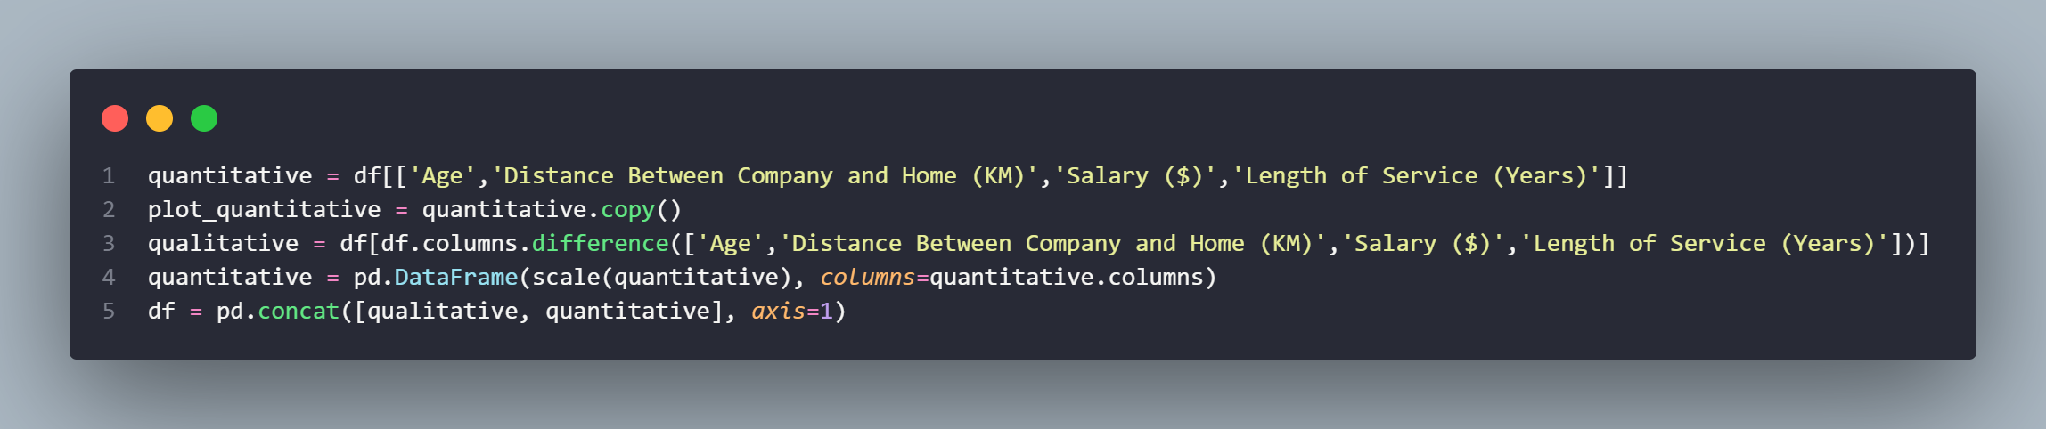
Scaling Data
Singapore Polytechnic
We scale the qualitative data, as this allows us to get the most accurate results for their respective data types
Various machine learning algorithms are sensitive when the data is not scaled.
There are various machine learning algorithms that use the same kind of basic strategies as their base concept under the algorithm.
These base concepts are totally based on the mapping of the distance between data points; scaling of the data makes it easy for a model to learn and understand the problem. (Verma, 2021)
Singapore Polytechnic

Slide 13
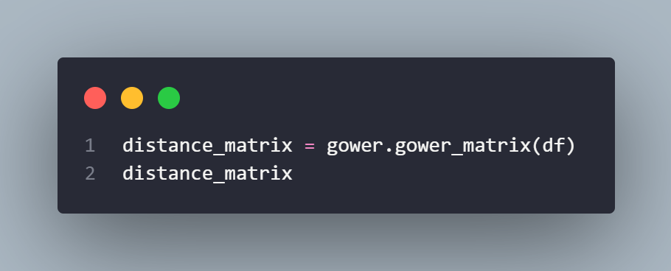
Data Encoding & Feature Engineeringz
Singapore Polytechnic
Why choose Gower Distance? Gower Distance can compute the distance between quantitative, qualitative and logical data.
Quantitative (interval): range-normalized Manhattan distance
Ordinal: variable is first ranked, then Manhattan distance is used with a special adjustment for ties
Nominal: variables of k categories are first converted into k binary columns and then the Dice coefficient is used
(Anand, 2020)
Singapore Polytechnic

Slide 14
03.
Modelling & Tuning
Singapore Polytechnic
Baseline, Initial Modelling and Hyperparameter Tuning
Singapore Polytechnic

Slide 15
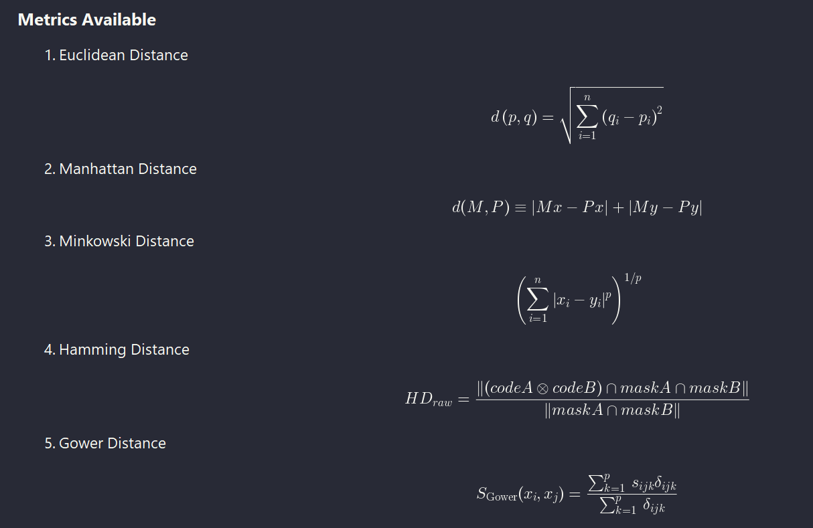
Distance Metrics
Singapore Polytechnic
We can see that there were 5 distance metrics that were considered.
The reason why we did not use Euclidean, Manhattan and Minkowski Distance was because the dataset was mixed. This meant that the dataset contained not only quantitative values but also qualitative values. This meant that these distances were not appropriate as they measure the quantitative distance, and categorical data does not fit this metric.
Likewise, Hamming Distance is only used for categorical, and falls short when dealing with quantitative values.
Hence, we use Gower Distance as it can deal with mixed data
Singapore Polytechnic

Slide 16
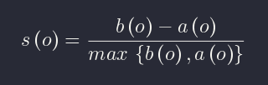
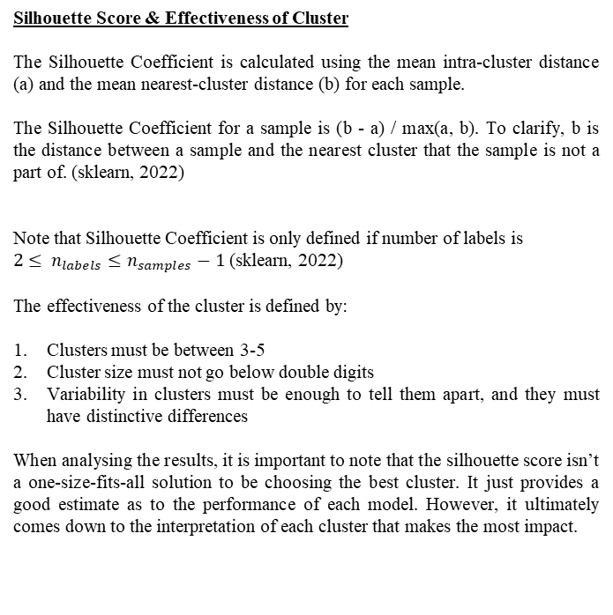
Evaluation Metrics
Singapore Polytechnic
Silhouette Score & Effectiveness of Cluster
The Silhouette Coefficient is calculated using the mean intra-cluster distance (a) and the mean nearest-cluster distance (b) for each sample.
The Silhouette Coefficient for a sample is (b - a) / max(a, b). To clarify, b is the distance between a sample and the nearest cluster that the sample is not a part of. (sklearn, 2022)
Note that Silhouette Coefficient is only defined if number of labels is
$2≤ n_{labels}≤n_{samples}−1$ (sklearn, 2022)
The effectiveness of the cluster is defined by:
Clusters must be between 3-5
Cluster size must not go below double digits
Variability in clusters must be enough to tell them apart, and they must have distinctive differences
When analysing the results, it is important to note that the silhouette score isn’t a one-size-fits-all solution to be choosing the best cluster. It just provides a good estimate as to the performance of each model. However, it ultimately comes down to the interpretation of each cluster that makes the most impact.
Singapore Polytechnic

Slide 17
Models Used
Singapore Polytechnic
Agglomerative Clustering
Density-Based Spatial Clustering of Applications with Noise (DBSCAN)
K-Medoids
Spectral Clustering
Singapore Polytechnic

Slide 18
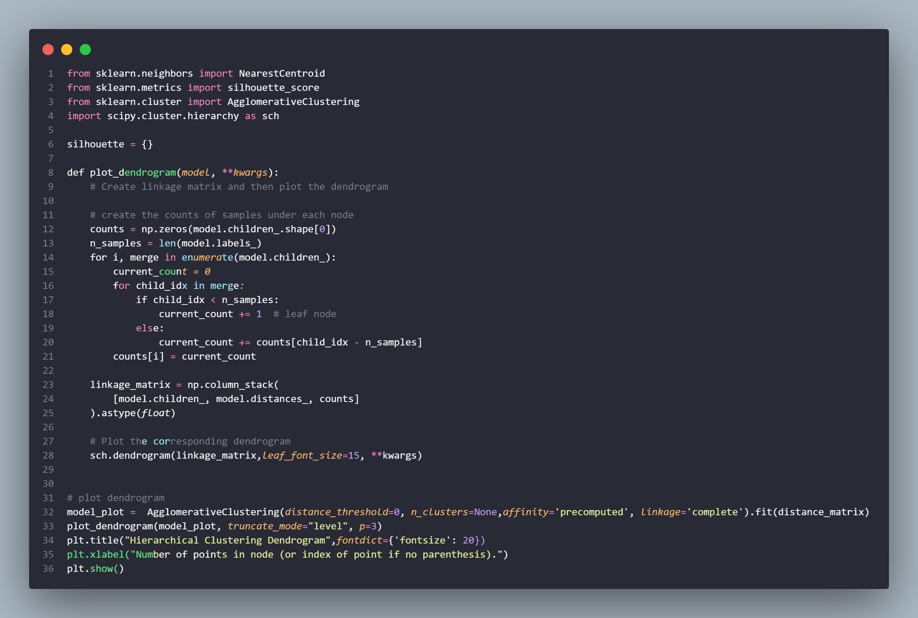
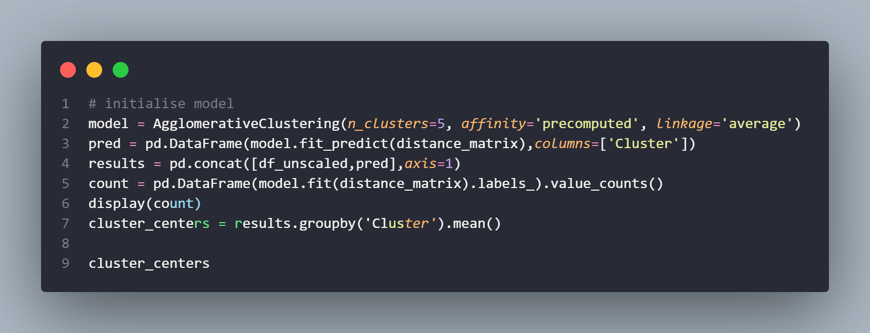
Agglomerative Clustering
Singapore Polytechnic
Agglomerative Clustering is a type of hierarchical clustering algorithm. It is an unsupervised machine learning technique that divides the population into several clusters such that data points in the same cluster are more similar and data points in different clusters are dissimilar. (Kumar, 2020)
How does it work?
Agglomerative Clustering works by going from the bottom up- all data points are a cluster of their own, and then it takes the 2 nearest clusters and joins them to form a new cluster. This step is repeated recursively until the number of clusters desired is reached.
Pros:
- Do not need to specify number of clusters: can read dendrogram to interpret optimal number of clusters
- Easy to understand and implement
Cons:
- Does not work well on large amounts of data
- Once a decision is made to cluster the 2 clusters, it cannot be undone
- Order, sensitivity and noise of data may affect results
Singapore Polytechnic

Slide 19
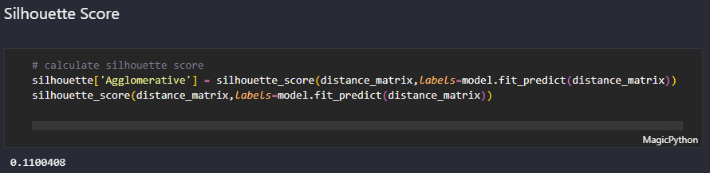
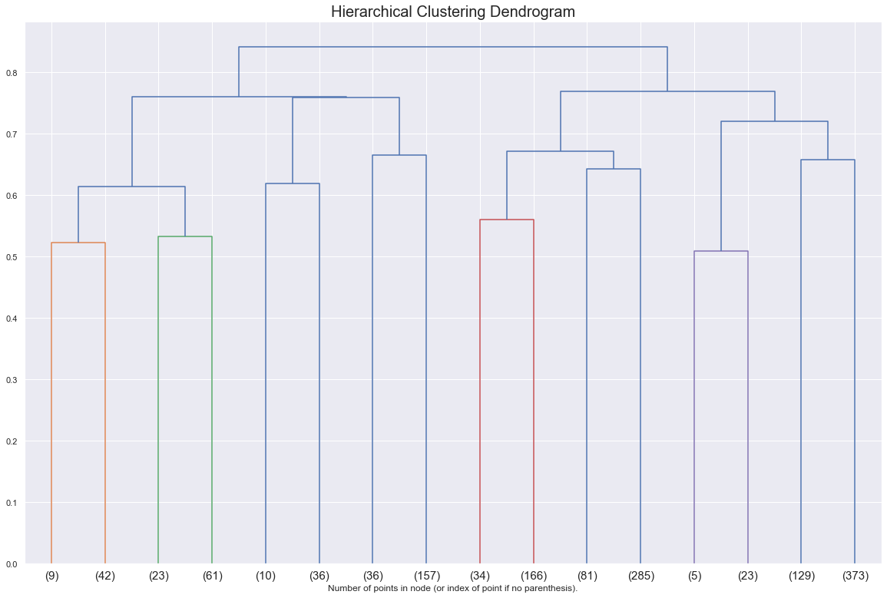
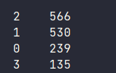
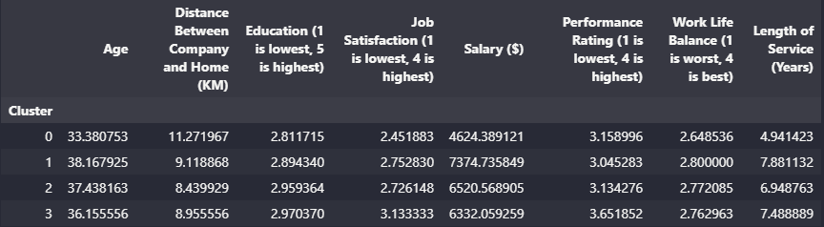
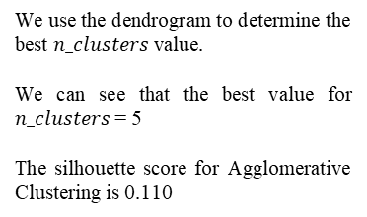
Singapore Polytechnic
We use the dendrogram to determine the best $n_clusters$ value.
We can see that the best value for $n_clusters$= 5
The silhouette score for Agglomerative Clustering is 0.110
Size of clusters
We can see that the distribution for each cluster is terrible, and skews more towards clusters 1 and 2. However, we can see that the dissimilarity in each cluster is of a decent amount.
This may be due to the data having too many outliers, noise and due to the limitations of not being able to go back after clustering the data, this may have further snowballed the problem.
This suggests that the clusters can differentiated from each other, and that there is at an identifiable difference in the properties of each cluster.
Singapore Polytechnic

Slide 20
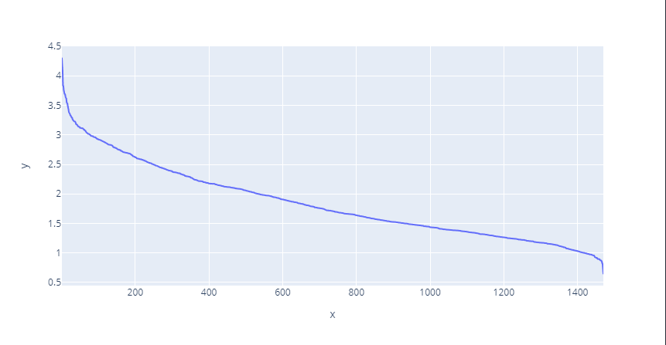
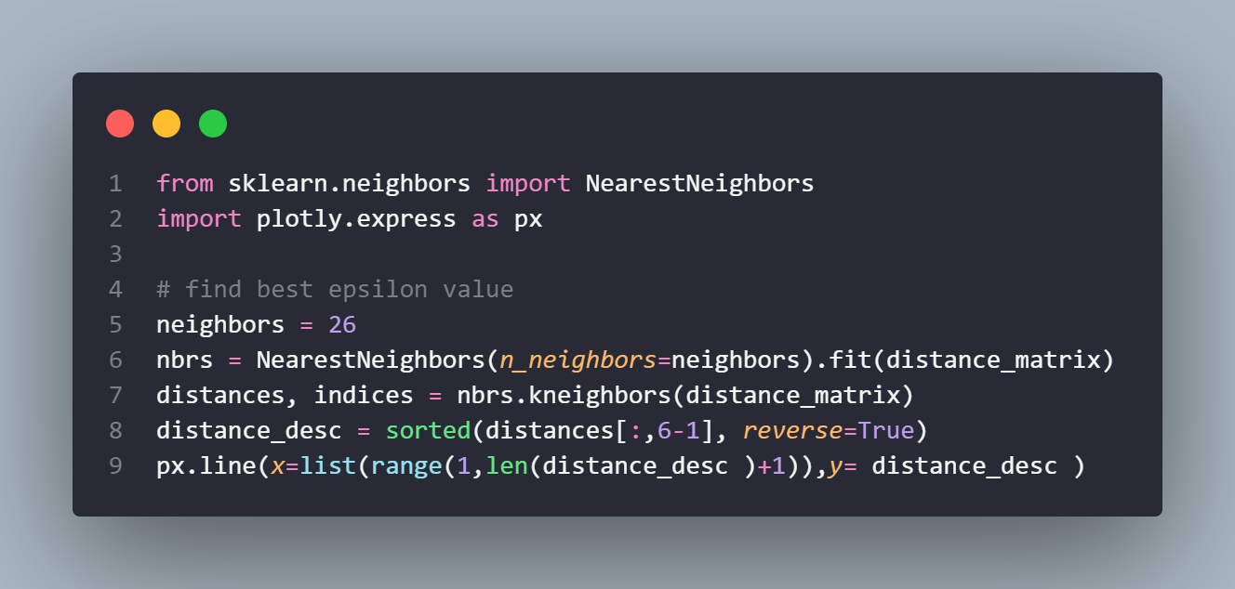
DBSCAN
Singapore Polytechnic
We use DBSCAN as it is not vulnerable to outlier values and does not require us to specify the number of clusters
How does it work? We first define 2 parameters:
Epsilon The epsilon determines the maximum radius of the neighbourhood that will encompass the points of the cluster. This epsilon will look for the minimum number of points within this epsilon to consider itself a cluster
Minimum Points Minimum points is a value the minimum number of points in the epsilon for the neighbourhood to be considered a cluster. High Minimum Points values make more clusters and result in more noise, and low Minimum Points values make more robust clusters but may ‘eat up’ smaller clusters present in the data
Pros:
Do not need to predefine number of clusters
Able to handle outliers
Able to handle non-linear shape of clusters etc. Circles, arbitrary shapes
Cons:
Unable to identify clusters of different density
Does not perform well with high-dimensional data
Sensitive to parameter values (epsilon, min points)
Singapore Polytechnic

Slide 21
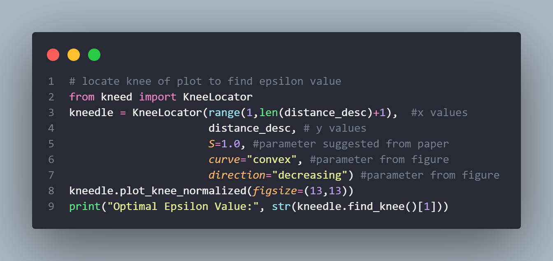
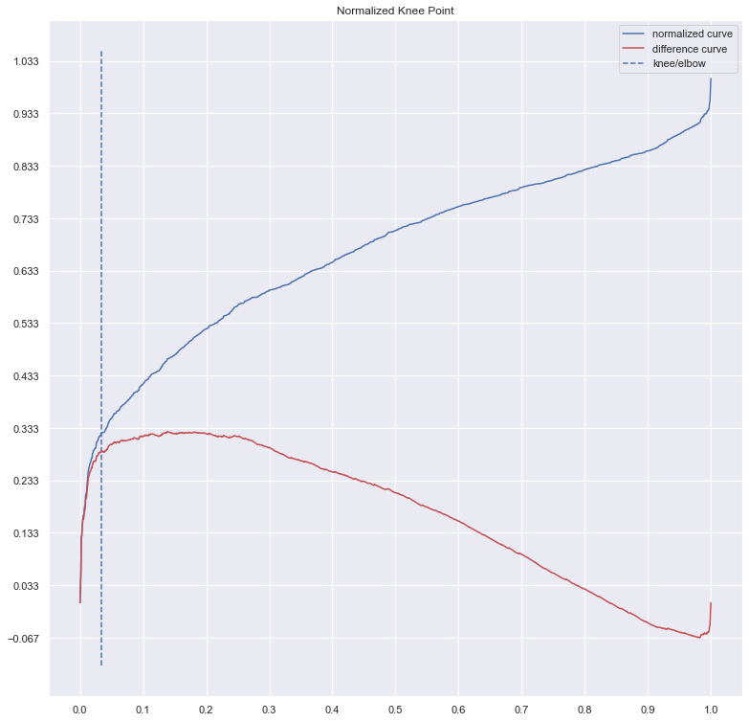
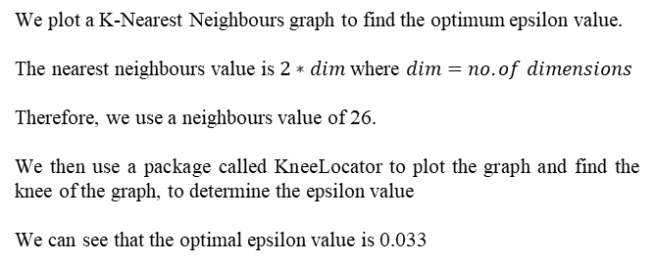
Singapore Polytechnic
We plot a K-Nearest Neighbours graph to find the optimum epsilon value.
The nearest neighbours value is $2∗dim$ where $dim=no. of dimensions$
Therefore, we use a neighbours value of 26.
We then use a package called KneeLocator to plot the graph and find the knee of the graph, to determine the epsilon value
We can see that the optimal epsilon value is 0.033
Singapore Polytechnic

Slide 22
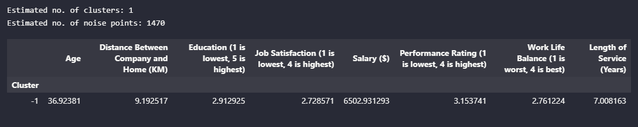
Singapore Polytechnic
The performance of DBSCAN on this dataset is terrible as there are no valid clusters available, as the data:
Has too many dimensions
Many varying densities
This causes the performance of the DBSCAN to be very bad.
Unable to calculate silhouette score as the length of unique labels must be bigger than 0.
We can see that the performance of the DBSCAN algorithm is terrible, even after finding the optimal epsilon and minpts values. Therefore, we will not use the DBSCAN algorithm for hyperparameter tuning
Singapore Polytechnic

Slide 23
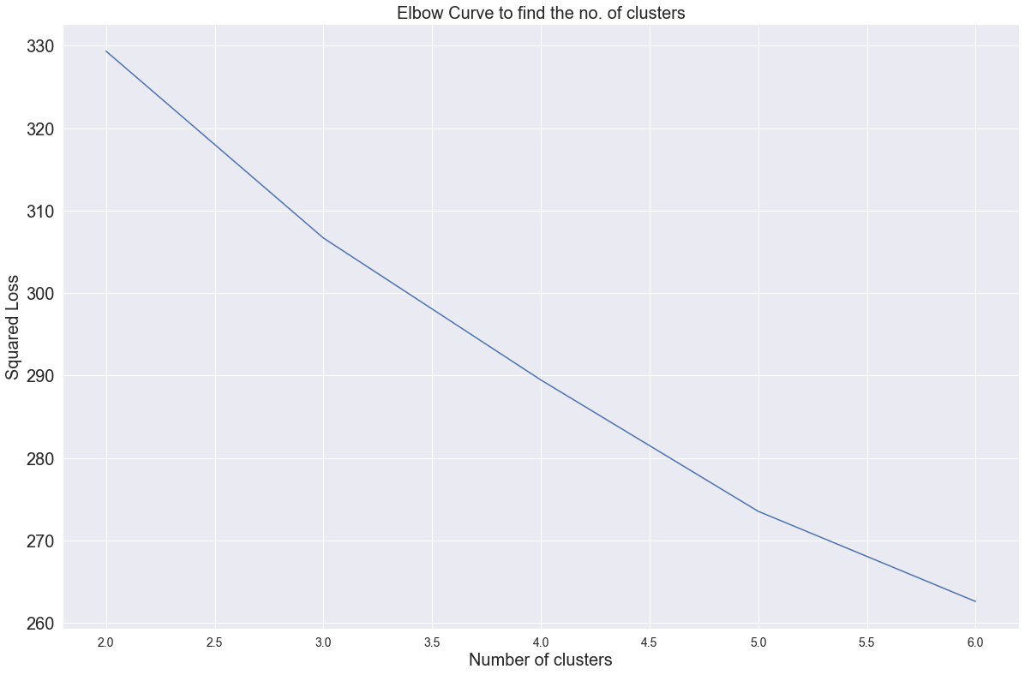
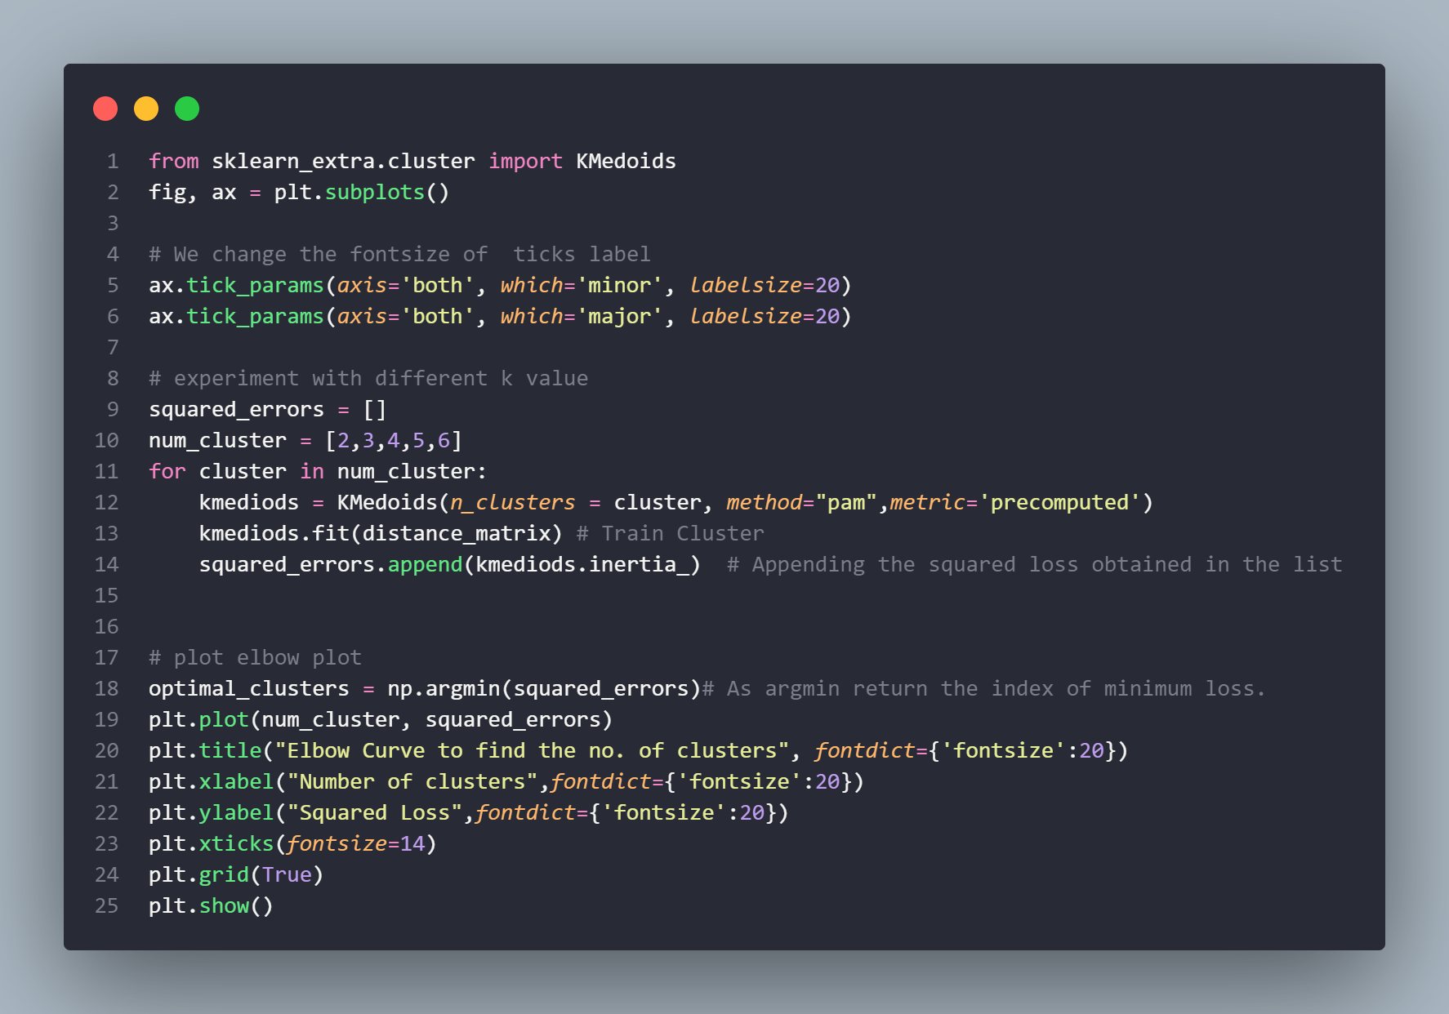
K-Medoids
Singapore Polytechnic
k-medoids minimizes the sum of dissimilarities between points labeled to be in a cluster and a point designated as the center of that cluster. In contrast to the k-means algorithm, k-medoids chooses datapoints as centers. (Mirkes, 2011)
How does it work?
Initialise: randomly select k of the n data points as the medoids
Assignment step: Associate each data point to the closest medoid.
Update step: For each medoid m and each data point o associated to m swap m and o and compute the total cost of the configuration (that is, the average dissimilarity of o to all the data points associated to m). Select the medoid o with the lowest cost of the configuration.
Repeat alternating steps 2 and 3 until there is no change in the assignment
Pros:
Able to solve K-means problems and produce empty clusters
Fast and converges quickly
Cons:
Requires precision
Complex
Singapore Polytechnic

Slide 24
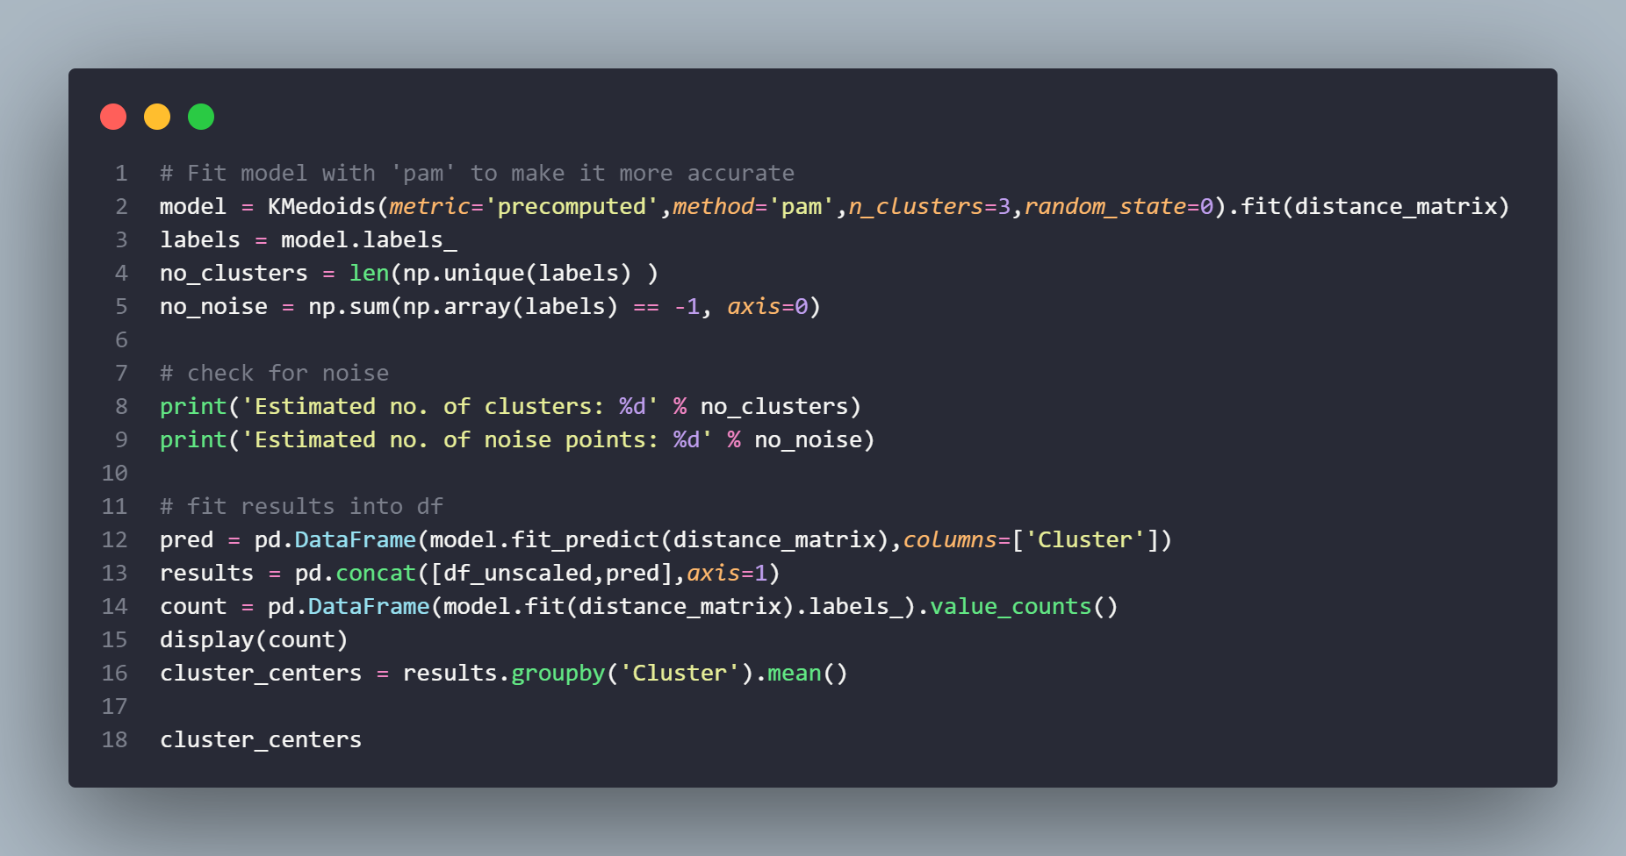
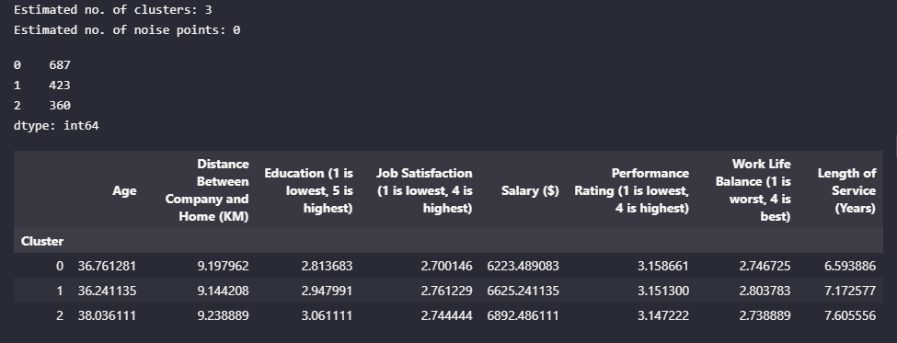

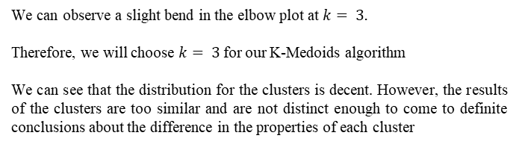
Singapore Polytechnic
We can observe a slight bend in the elbow plot at $k= 3.$
Therefore, we will choose $k= 3$for our K-Medoids algorithm
We can see that the distribution for the clusters is decent. However, the results of the clusters are too similar and are not distinct enough to come to definite conclusions about the difference in the properties of each cluster
Silhouette Score is 0.08, which means that the model is decent but not the best
Singapore Polytechnic

Slide 25
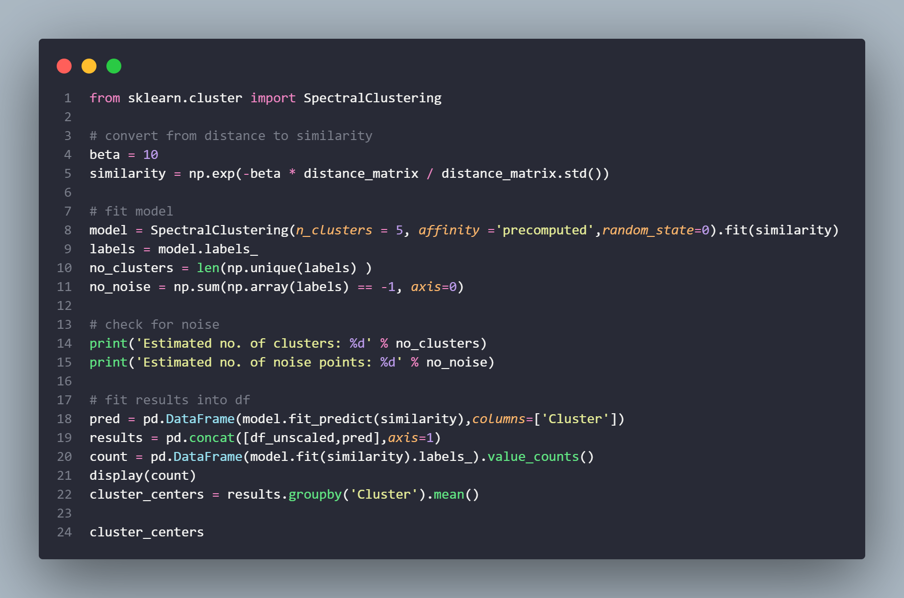
Spectral Clustering
Singapore Polytechnic
Spectral clustering is a technique with roots in graph theory, where the approach is used to identify communities of nodes in a graph based on the edges connecting them. The method is flexible and allows us to cluster non graph data as well. (Fleshman, 2019)
How does it work?
Construct similarity graph
Embed data points in low-dimensional space with the help of eigenvectors of Laplacian graph
Classical clustering algorithm is applied to partition embedding
Pros:
Makes no assumption about the shape of the cluster
K-Mean requires an iterative process to find local minima
Cons:
Use of K-Means clustering in the final step implies that the clusters are not always the same. They may vary depending on the choice of initial centroids. (Doshi, 2019)
Computationally expensive for large datasets — This is because eigenvalues and eigenvectors need to be computed, and then we must do clustering on these vectors. For large, dense datasets, this may increase time complexity quite a bit. (Doshi, 2019)
Singapore Polytechnic

Slide 26
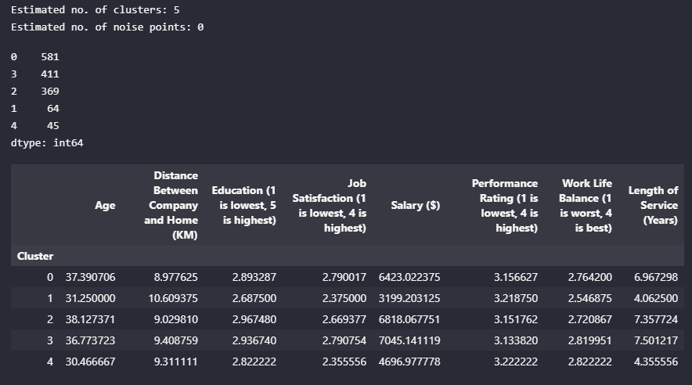
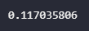
Spectral Clustering
Singapore Polytechnic
After initialising a random Beta value and n_clusters value, we can see that the performance of the Spectral Clustering is the best so far. It is able to tread the lines between identifiable differences in clusters while maintaining a reasonable cluster size.
Understandably, the cluster variance in cluster size is pretty high. However, this is a rather good result from the initial modelling already, all clusters are at least double digits in size.
Silhouette Score is 0.117, which means that the model is the best
Singapore Polytechnic

Slide 27
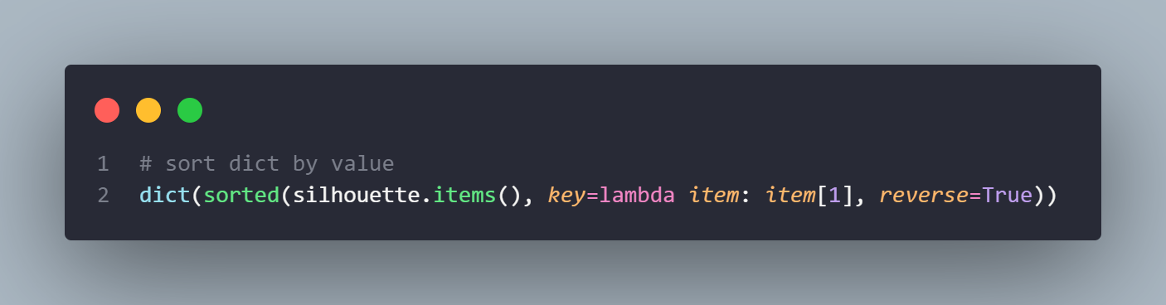
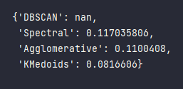
Model Analysis
Singapore Polytechnic
We can see that the silhouette score for Spectral Clustering is the highest, at 0.117
Therefore, we will proceed with Spectral Clustering & Agglomerative Clustering for hyperparameter tuning
Singapore Polytechnic

Slide 28
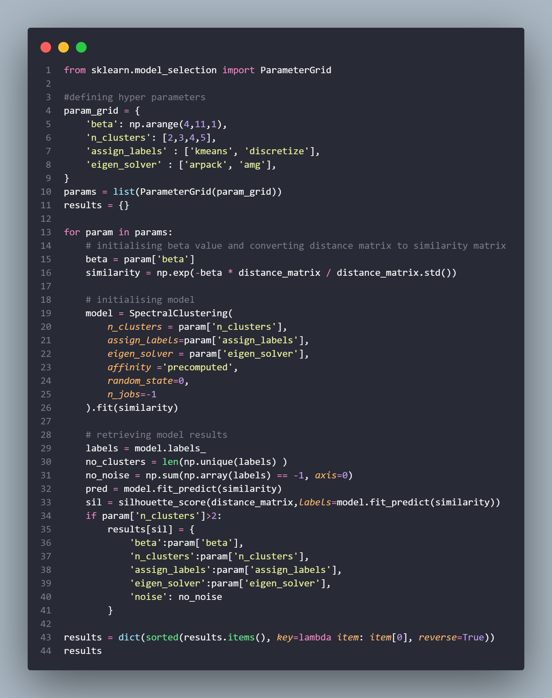
Spectral Clustering (Hyperparameter Tuned)
Singapore Polytechnic
From the previous results of the clusters, we can observe that the optimum number of clusters was roughly between 3-5.
Hence, we will consider these factors when considering the best result to use and analyse:
Clusters must be between 3-5
Cluster size must not go below double digits
Variability in clusters must be enough to tell them apart, and they must have distinctive differences
When analysing the results, it is important to note that the silhouette score isn’t a one-size-fits-all solution to be choosing the best cluster. It just provides a good estimate as to the performance of each model. However, it ultimately comes down to the interpretation of each cluster that makes the most impact.
Singapore Polytechnic

Slide 29
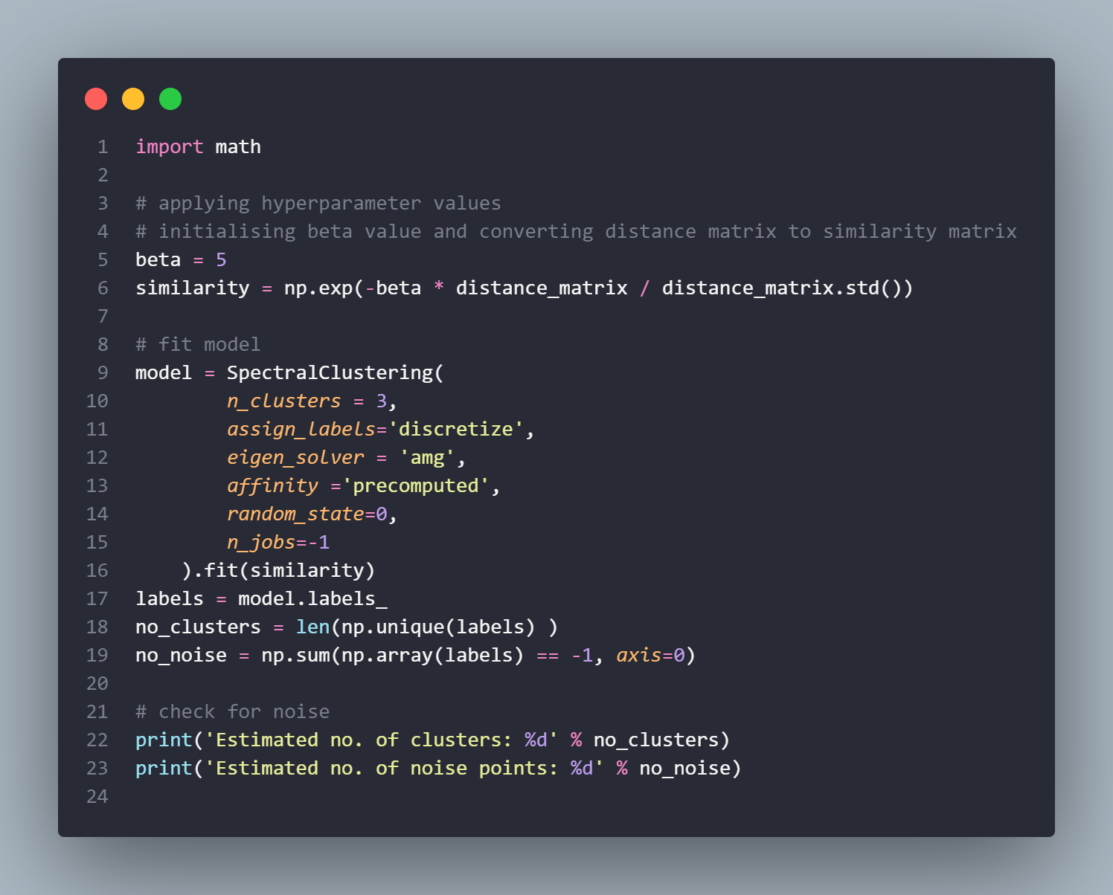
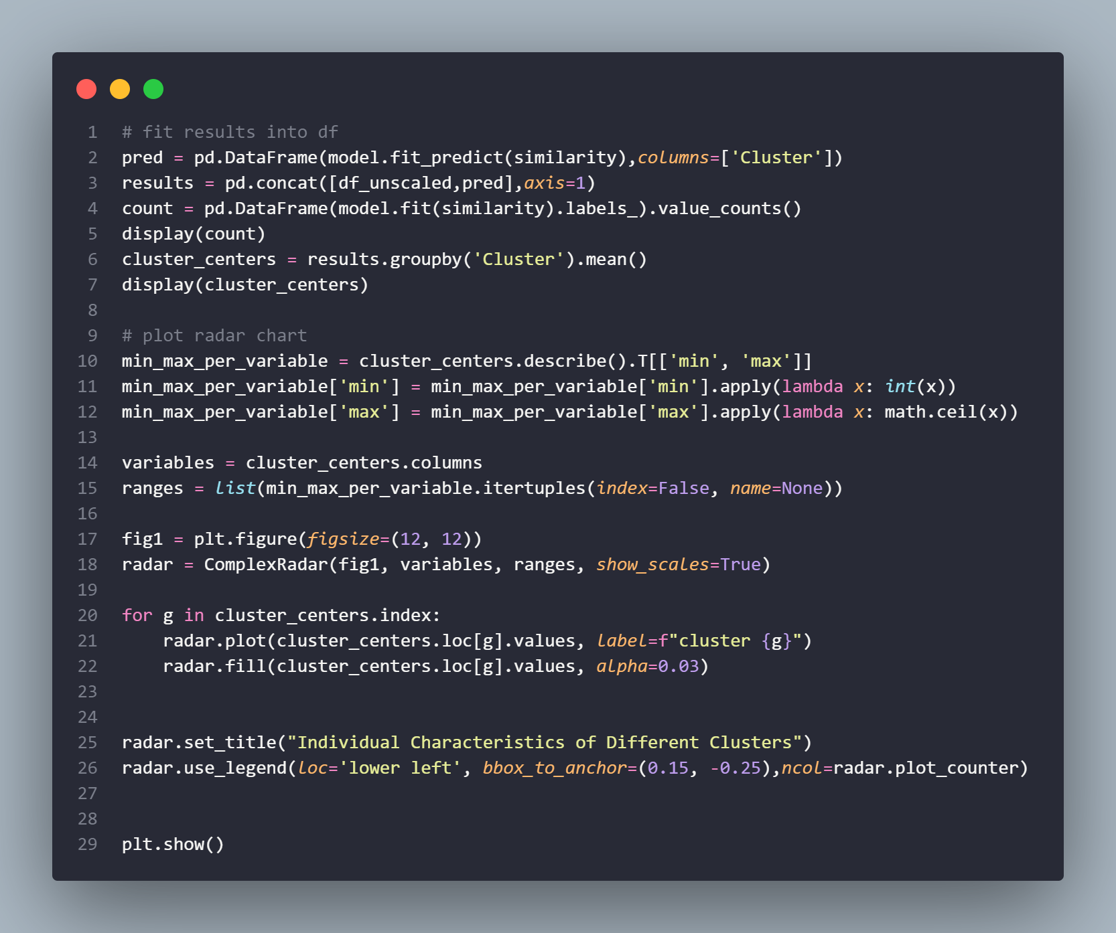
Singapore Polytechnic
Initialising the model and plotting results
Singapore Polytechnic

Slide 30
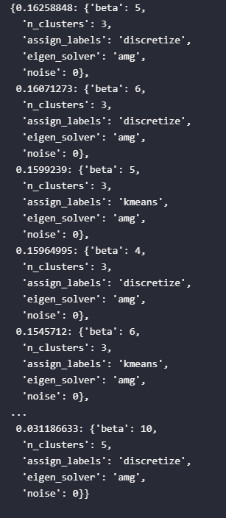
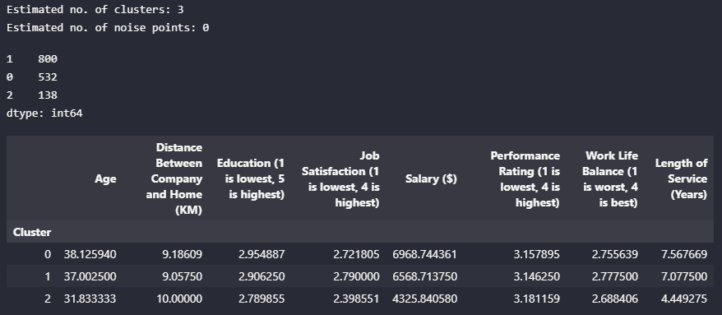
Singapore Polytechnic
Interpreting and visualising results
Singapore Polytechnic

Slide 31
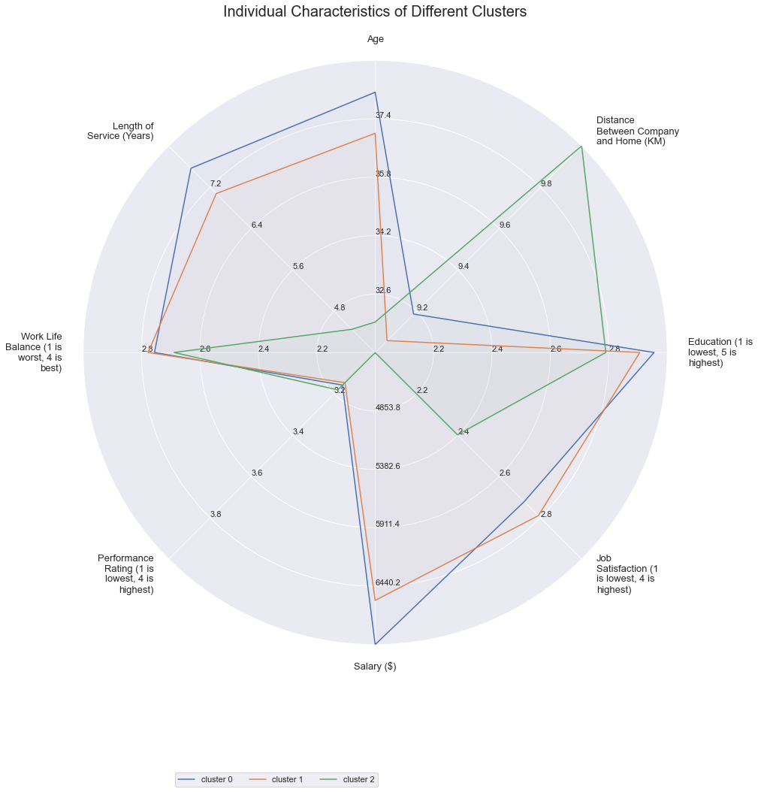
Singapore Polytechnic
Results Interpretation
We can see that the results of the hyper-parameter tuning are not effective. This is because there are similarities for cluster 0 and cluster 1 for every single numerical column.
This means that the algorithm was not effective at differentiating the 2 clusters from each other.

Slide 32
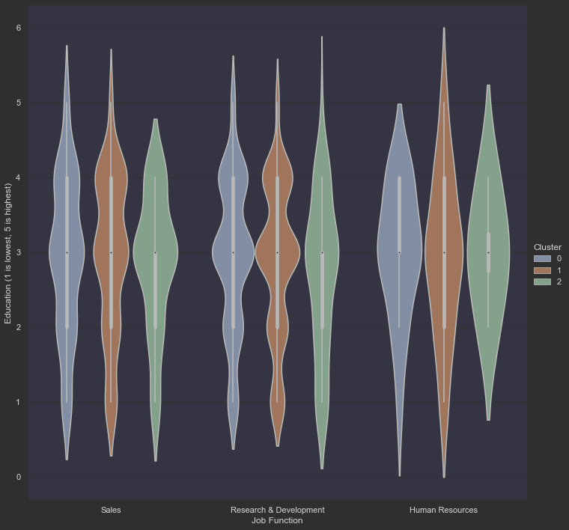
Singapore Polytechnic
Results Interpretation
Through this violin plot, we can see that the variation in all the clusters is roughly the same, and that they are evenly spaced.
Additionally, we can see that there is no sizeable difference in the clusters. This means that there is no meaningful difference between the 3 clusters

Slide 33
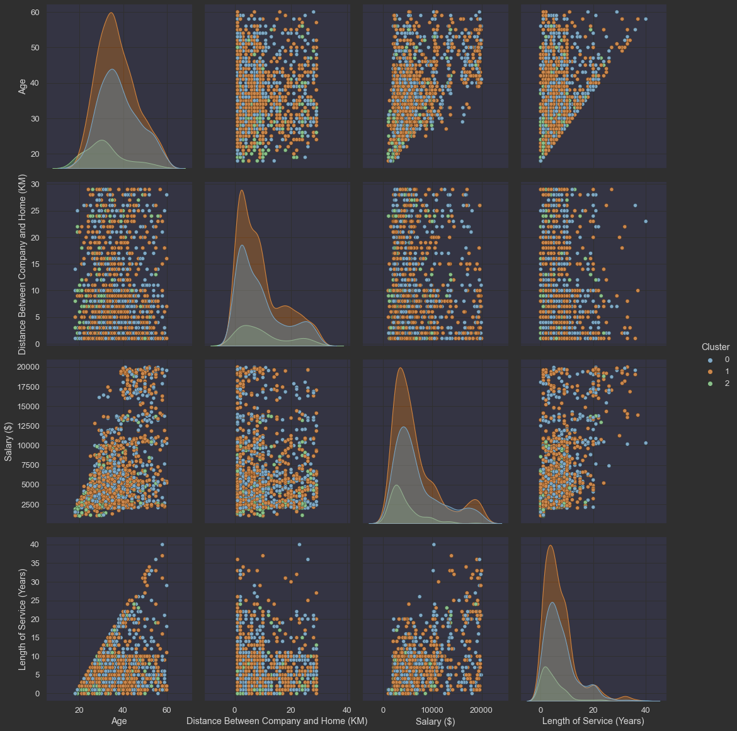
Singapore Polytechnic
Results Interpretation
We can see that the distribution of the data is not equal. This may mean that the size of each clusters are different.
Although it is not a bad thing, the problem is that they are spaced too far apart, and this may lead to the clusters not being equal and the clustering not being effective enough.
We can also see that there is no distinct separation in the scatter plots. This means that the clusters created by the Spectral Clustering model has no effect on differentiating the dataset given.

Slide 34
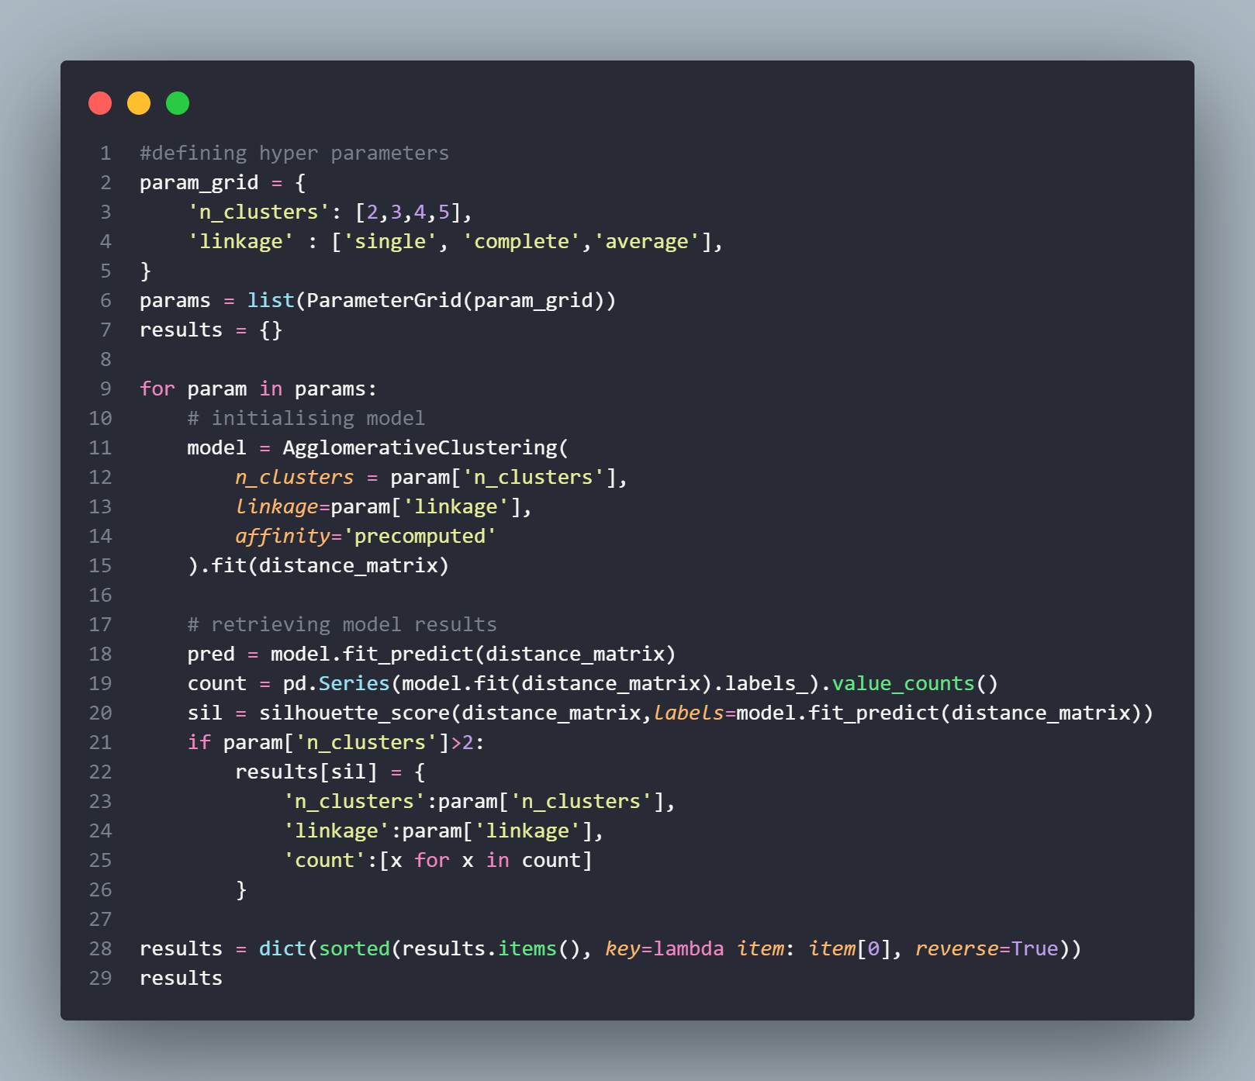
Agglomerative Clustering (Hyperparameter Tuned)
Singapore Polytechnic
From the previous results of the clusters, we can observe that the optimum number of clusters was roughly between 3-5.
Hence, we will consider these factors when considering the best result to use and analyse:
Clusters must be between 3-5
Cluster size must not go below double digits
Variability in clusters must be enough to tell them apart, and they must have distinctive differences
When analysing the results, it is important to note that the silhouette score isn’t a one-size-fits-all solution to be choosing the best cluster. It just provides a good estimate as to the performance of each model. However, it ultimately comes down to the interpretation of each cluster that makes the most impact.
Singapore Polytechnic

Slide 35
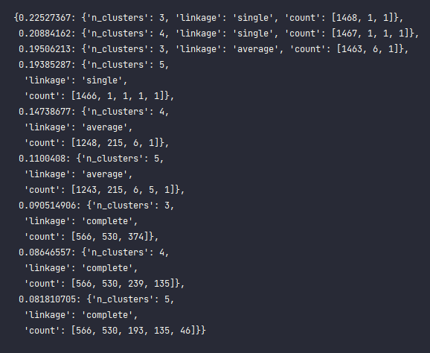
Singapore Polytechnic
Initialising the model and plotting results of best hyperparameters
Singapore Polytechnic

Slide 36
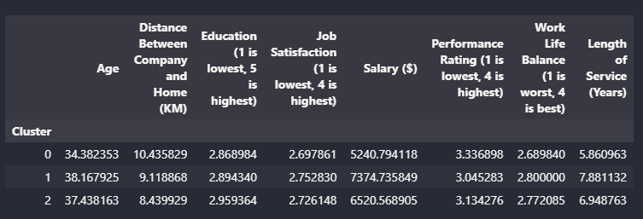
Singapore Polytechnic
Initialising the model and plotting results of best hyperparameters
Singapore Polytechnic

Slide 37
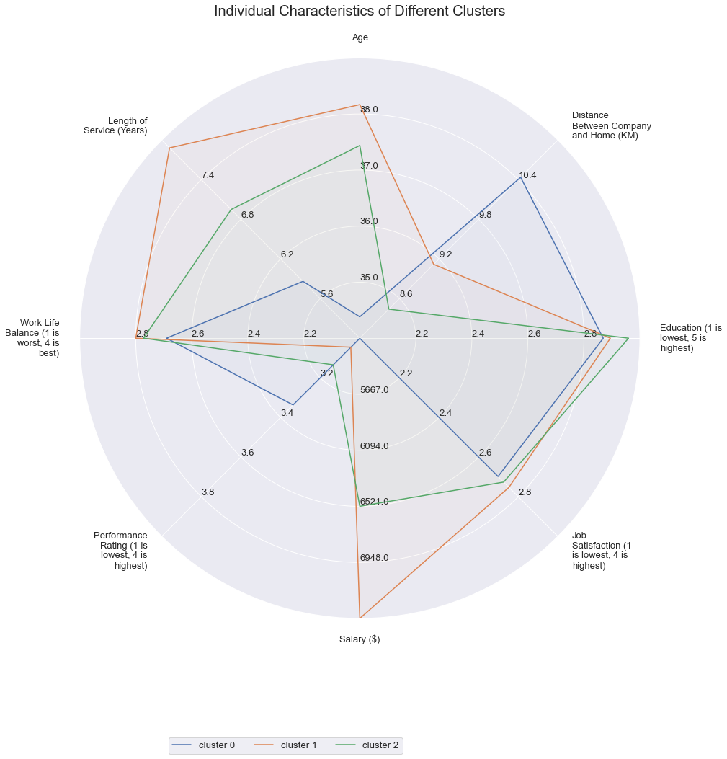
Singapore Polytechnic
Results Interpretation
We can see that the results of the hyper-parameter tuning are effective. This is because there are few similarities all clusters for every single numerical column.
This means that the hyperparameter-tuned algorithm was effective at differentiating the 3 clusters from each other.
We can see that the older the staff, the greater the salary. This may be since older staff are more experienced, and that this industry experience accounts for their competency, which then accounts for the salary.
However, we can observe that the inverse is true for Performance Rating. The younger staff are actually rated higher than the older staff. This suggests that the increase in pay is due to company loyalty, as the pay raise is not credited to an increase in performance or competency of the staff.
Additionally, we can see that educational qualifications do not matter when it comes to the hireabiity of the staff in the company, nor does it affect salary. All 3 clusters share around a 2.9-3.1 in the scale of educational qualifications. This also further justifies the previous point on industry experience.
This suggests that this company focuses more on the job training as opposed to educational qualifications, leading me to believe that the company is a trade-focused company as opposed to a academia-based company. Examples of these 2 are Oil-Rig workers compared to Teachers.

Slide 38
Singapore Polytechnic
Results Interpretation
We can also see that the work-life balance for the older staff is greater, as they take on more senior roles in the company with time. These promotions to senior positions mean that they have greater out-of-office responsibilities, and do not have to deal with the manual labour that comes with the job, thus accounting for better work-life balance.
An interesting fact is that the distance between company for home is drastically different for the newer employees. This may be because young people that were hired haven’t decided to settle down yet, as they will most probably purchase a house nearer to their workplace when they begin to commit to the job and its responsibilities. This means that the housing that they are staying in will be further away since they are not ready to make that commitment.
As expected, the age of the employees also directly correlate to the length of service at the company. This suggests that in the cultural society that this company is based in, there tends to be greater employee retention, suggesting that the employee will tend to work at one company for a longer duration of time compared to normal. This means that if the employee chooses to resign, then there needs to be an internal investigation carried out to analyse the cause and effect. This also further backs up the claim of the previous paragraph, as the older employees get, the more they will want to settle down in their life, and with the same company too.

Slide 39
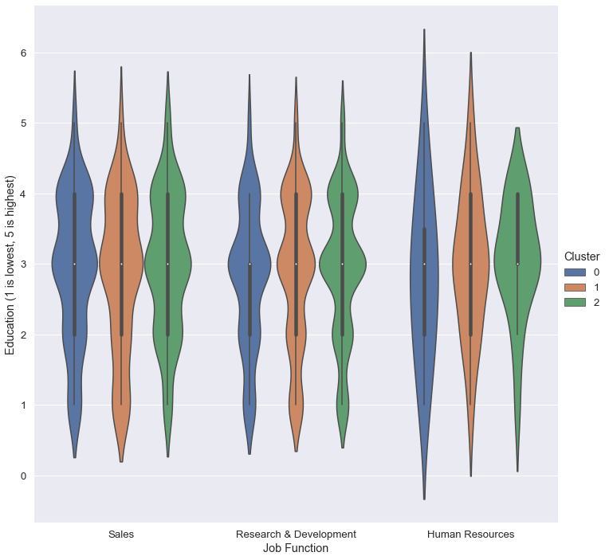
Singapore Polytechnic
Results Interpretation
Through this violin plot, we can see that the variation in all the clusters is roughly the same, and that they are evenly spaced.
Additionally, we can see that there is some sizeable difference in the clusters. This means that there is a slight meaningful difference between the 3 clusters

Slide 40
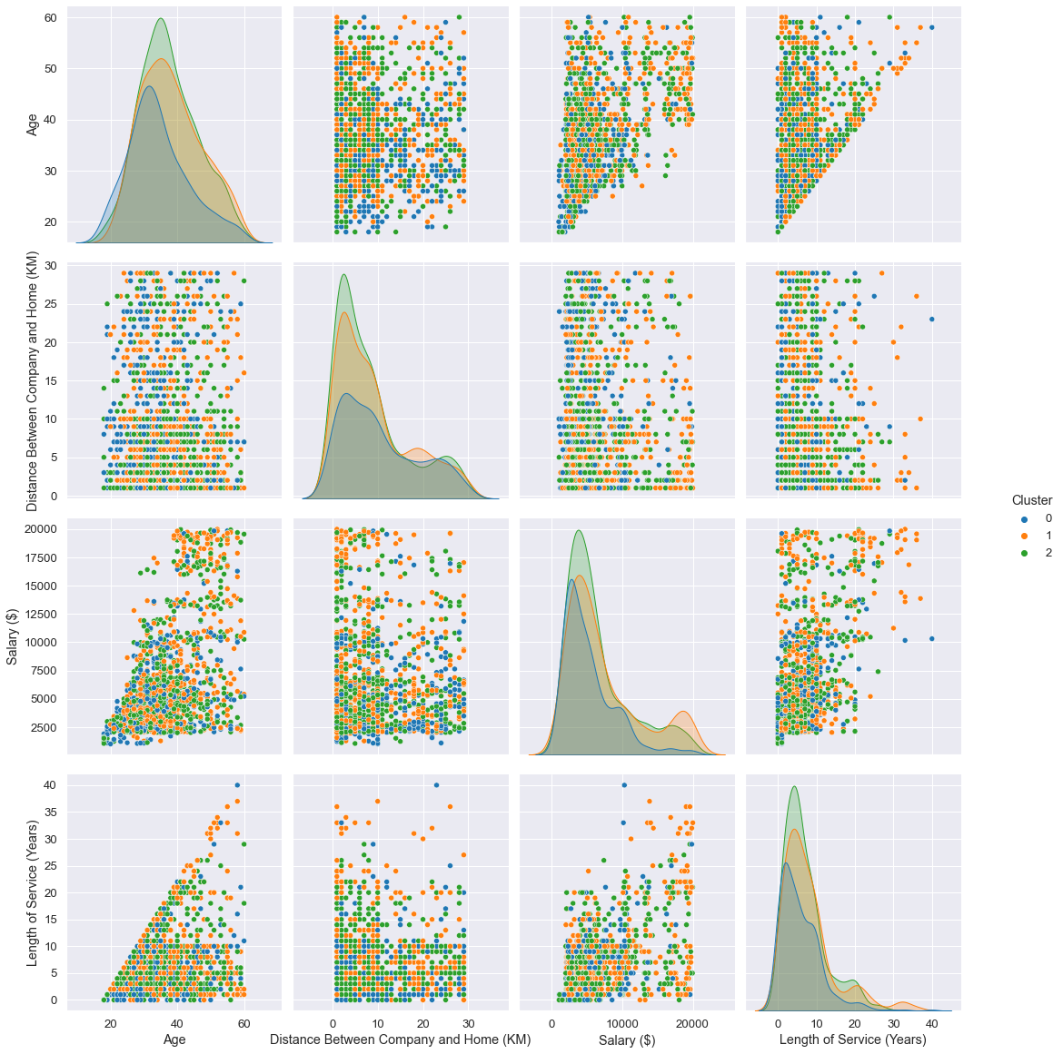
Singapore Polytechnic
Results Interpretation
We can see that the distribution of the data is equal. This may mean that the size of each clusters are similar.
Although it is not a bad thing, the problem is that they are spaced too far apart, and this may lead to the clusters not being equal and the clustering not being effective enough.
We can also see that there is no distinct separation in the scatter plots. This means that the clusters created by the Agglomerative Clustering model has no effect on differentiating the dataset given.

Slide 41
04.
Conclusion
Singapore Polytechnic
Conclusion of Insights
Singapore Polytechnic

Slide 42
Model Interpretation
Singapore Polytechnic
When we interpret the results and performance of this model, we can see that it is not optimal. Even though we went through hyper parameter tuning, the results were not the best.
Reasons being:
Complete linkage calculates the similarity of the farthest away pair. One disadvantage to this method is that outliers can cause less-than-optimal merging.
Agglomerative clustering has large storage requirements, and they can be computationally intensive. This is especially true for big data. These complex algorithms are about four times the size of the K-means algorithm.
Merging can’t be reversed, which can create a problem if you have noisy, high-dimensional data
The quality of the dataset provided was not high enough of quality in terms of variability of each cluster and number of rows provided
Singapore Polytechnic

Slide 43
Conclusion
Singapore Polytechnic
In conclusion, there are more benefits for employees the longer they stay at the company. To enter the company, one must have industry experience as educational qualifications are not prioritised.
If the company wishes to keep their employees, they should offer accommodation for their newer employees, as length of service is a chicken and egg problem.
Employees cannot get promoted if they do not stay long enough, but they will not stay long enough if they do not get promoted.
To mitigate this risk, the company should not only offer accommodation, but also offer to upgrade the employee’s skills to reduce the risk of their employees getting poached.
Singapore Polytechnic

Slide 44
Singapore Polytechnic
Citations
Verma, Y. (2021). Why Data Scaling is important in Machine Learning & How to effectively do it. [online] Analytics India Magazine. Available at: https://analyticsindiamag.com/why-data-scaling-is-important-in-machine-learning-how-to-effectively-do-it/#:~:text=Scaling%20the%20target%20value%20is [Accessed 15 Jun. 2022]
Headstart (2020). Gender bias in the workplace - why does it still happen? [online] Headstart. Available at: https://www.headstart.io/insights/gender-bias-in-the-workplace-why-does-it-still-happen/ [Accessed 3 Aug. 2022]
Anand, D. (2020). Gower’s Distance. [online] Analytics Vidhya. Available at: https://medium.com/analytics-vidhya/gowers-distance-899f9c4bd553 [Accessed 6 Aug. 2022].
Kumar, S. (2020b). Agglomerative Clustering and Dendrograms — Explained. [online] Medium. Available at: https://towardsdatascience.com/agglomerative-clustering-and-dendrograms-explained-29fc12b85f23 [Accessed 6 Aug. 2022].
Kumar, A. (2020a). KMeans Silhouette Score With Python Examples - DZone AI. [online] dzone.com. Available at: https://dzone.com/articles/kmeans-silhouette-score-explained-with-python-exam#:~:text=Silhouette%20score%20is%20used%20to [Accessed 7 Aug. 2022].
E.M., Mirkes. (2011). K-means and K-medoids. [online] www.math.le.ac.uk. Available at: http://www.math.le.ac.uk/people/ag153/homepage/KmeansKmedoids/Kmeans_Kmedoids.html [Accessed 7 Aug. 2022].
Fleshman, W. (2019). Spectral Clustering. [online] Medium. Available at: https://towardsdatascience.com/spectral-clustering-aba2640c0d5b [Accessed 7 Aug. 2022].
Doshi, N. (2019). Spectral Clustering. [online] Medium. Available at: https://towardsdatascience.com/spectral-clustering-82d3cff3d3b7 [Accessed 7 Aug. 2022].
Singapore Polytechnic

Slide 45
Thanks!
Singapore Polytechnic
Do you have any questions?
Please keep this slide for attribution
Singapore Polytechnic

